Slide 1
OSRM Past/Current/Future
Xun(Perry) Liu
02/26/2020
Notes:
https://spaces.telenav.com:8443/display/TAS/EV+demo+based+on+OSRM

Slide 2
Agenda
What’s OSRM
Why OSRM
What’s happening & next

Slide 3

What is OSRM
osrm-backend
High performance routing engine written in C++14 designed to run on OpenStreetMap data.
osrm-frontend
The web frontend of osrm-backend, builds heavily on top of Leaflet.
The frontend served at https://map.project-osrm.org

Slide 4
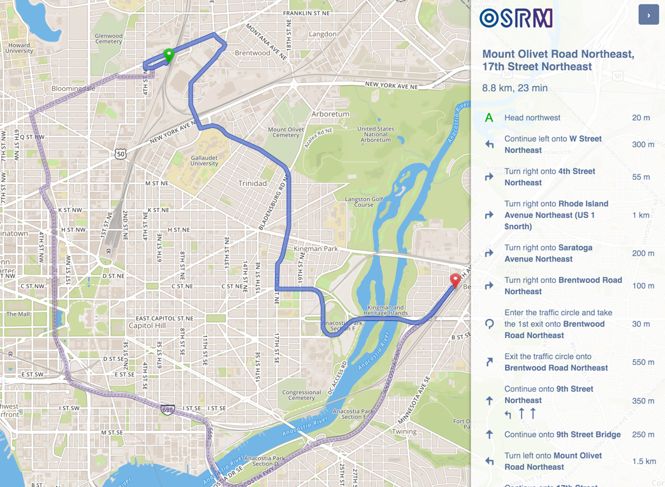
What OSRM could do
- Lowest cost path and turn by turn navigation

Slide 5
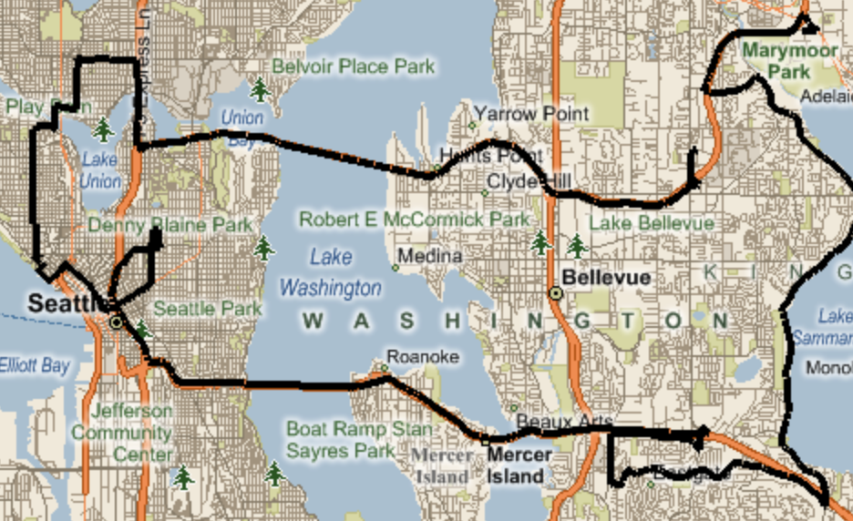
What OSRM could do
- Shortest path and turn by turn navigation
- MapMatching, enable user to do MapMaking

Slide 6
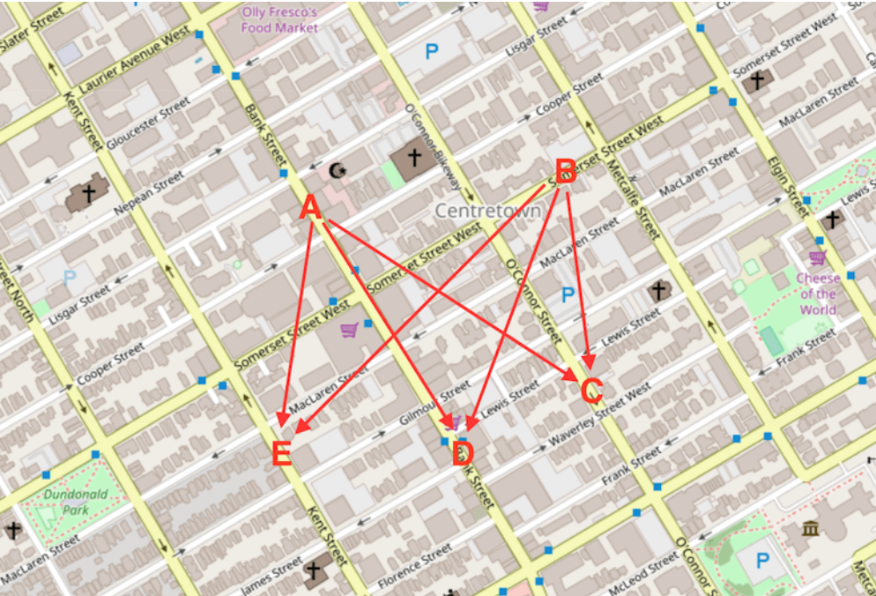
What OSRM could do
- Shortest path and turn by turn navigation
- MapMatching, enable user to do MapMaking
- Table service

Slide 7

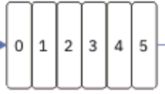
How OSRM work with Telenav Stack
Direction Service
OSRM Tech Stack
Matching Service
HERE
OSRM Data Compiler
Table Service
Tile Service
OSM
PBF
OSRM Graph Data
OSRM Routing Engine
Ranking Service
TomTom
OASIS Service
MapMaking
TomTom Traffic
Graph API

Slide 8
Why OSRM
Work with community
- A different view on same problem
- Advanced strategy
Popular algorithm for cloud
- CRP/MLD
- Hidden Markov Map Matching
Join Na Team

Slide 9
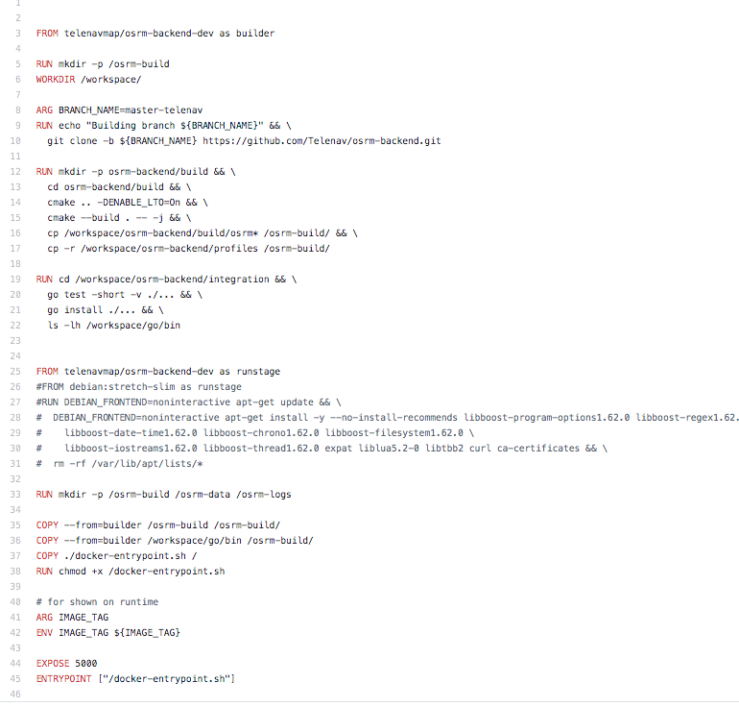


Join Na Team

Slide 10
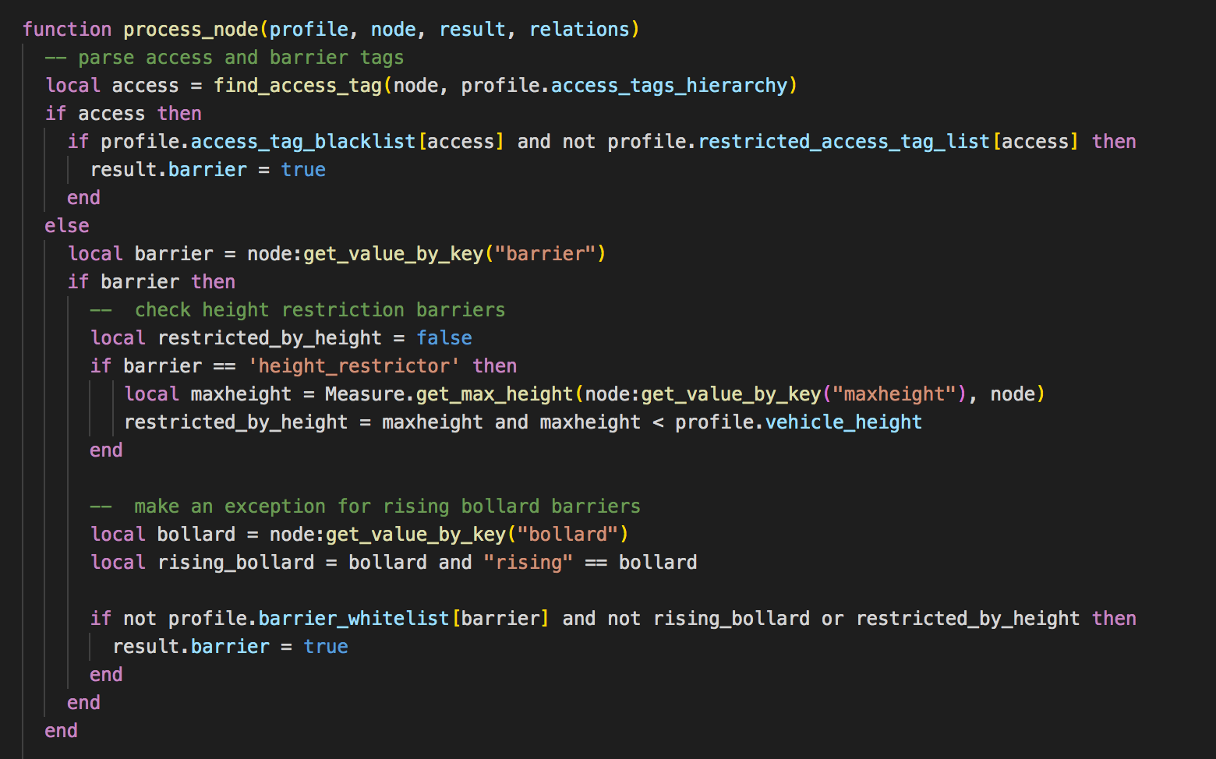

Join Na Team

Slide 11
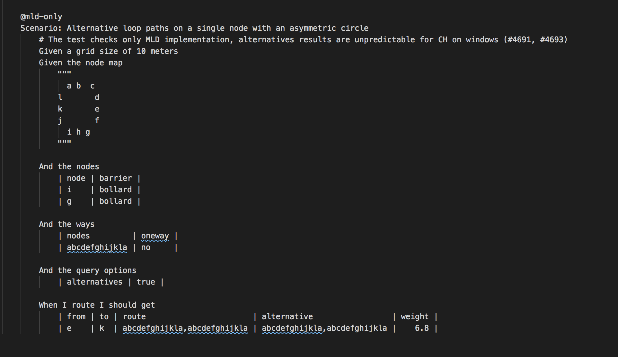

Join Na Team

Slide 12

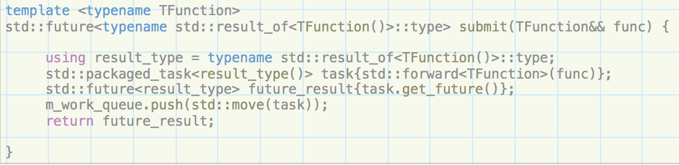
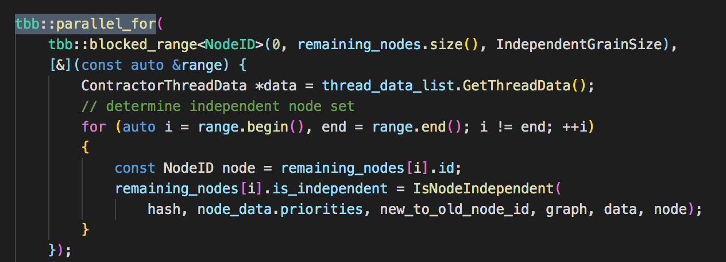

Join Na Team

Slide 13
Why OSRM
Work with community
- A different view on same problem
- Advanced strategy
Popular algorithm for cloud
- CRP/MLD
- Hidden markov map matching
Join Na Team

Slide 14

OSRM Characteristics - Fast
1 Origin
0.127
seconds
to
60 Destinations
(radius 15 km)

Slide 15
OSRM Algorithms
 | Contraction Hierarchies (CH) | Multi-Level Dijkstra (MLD)
Paper |  | Customizable Route Planning
Pre-processing (i.e. data compilation) | Very slow | Slow
Query | Extremely fast | Fast
Dynamic data injection (e.g. traffic) | Hard (too slow) | Minutes per injection(customize)
Processing Pipeline | osrm-extract osrm-contract osrm-routed | osrm-extract osrm-partition osrm-customize osrm-routed
* We’re focusing on the MLD algorithm.

Slide 16
Customizable Route Planning
Notes:
Picture layout

Slide 17
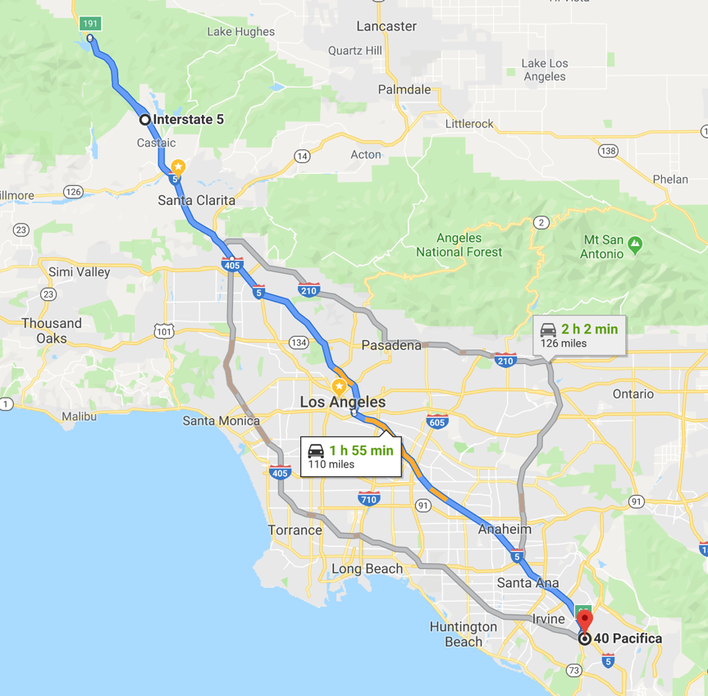
How to calculate route
Notes:
Picture layout

Slide 18
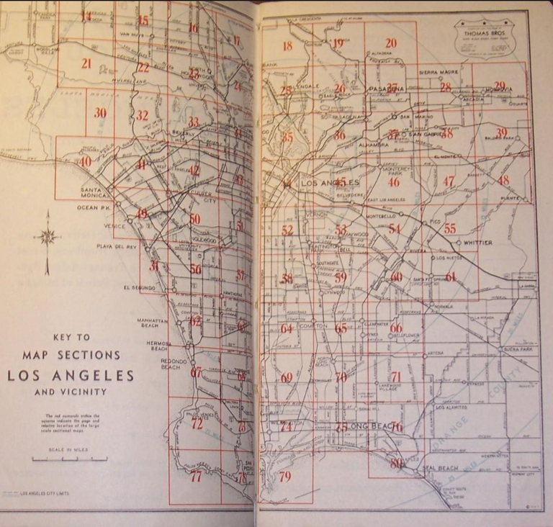
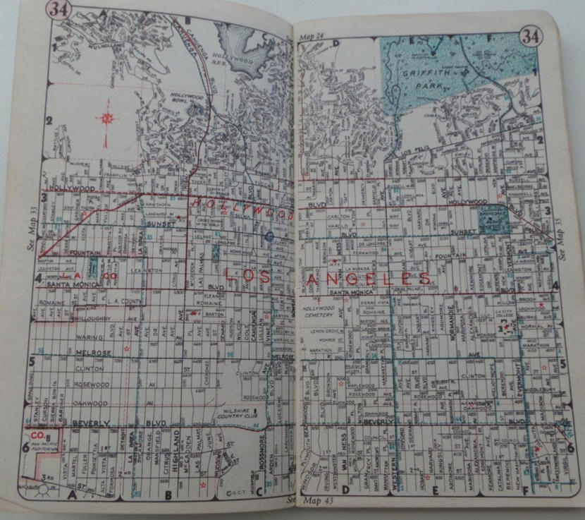
Thomas Guide
Notes:
Picture layout

Slide 19
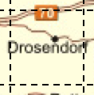
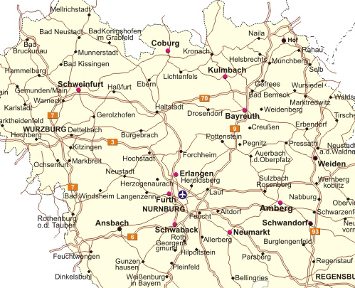
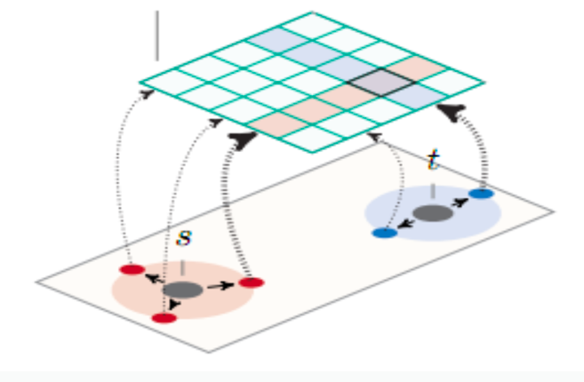
Access Points
Partition the graph
Access Points
Access Points
Keep update cost between access points

Slide 20
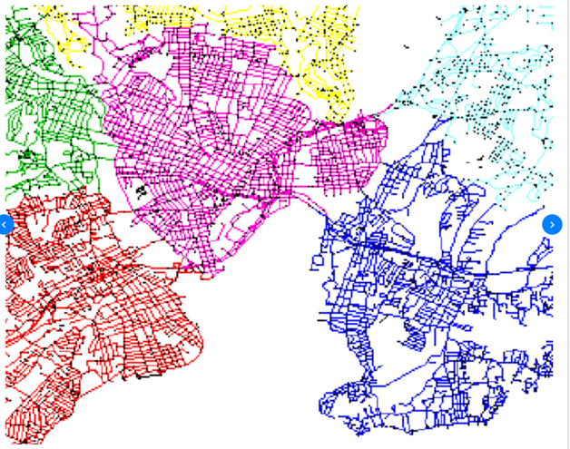
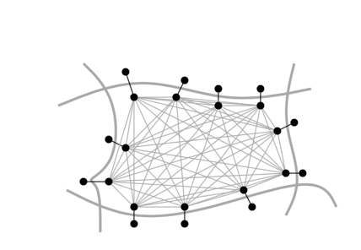
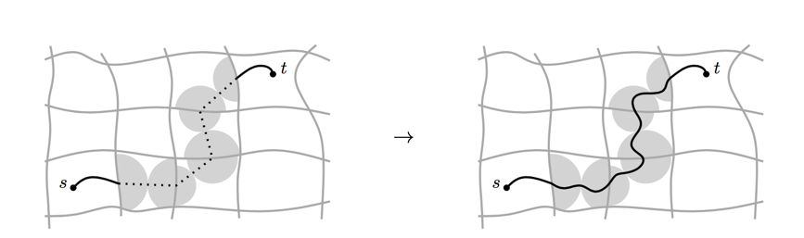
Customizable Route planning
Step 1: Graph preprocessing
Graph partition, preprocessing, hours
Step 2: Customization
Apply dynamic information with cost model
Each round of traffic update, seconds
Step 3: Query
Real time, per request, mili-seconds

Slide 21
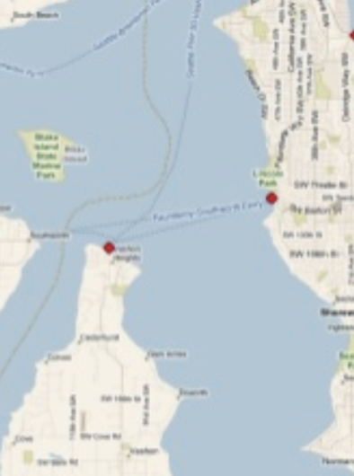
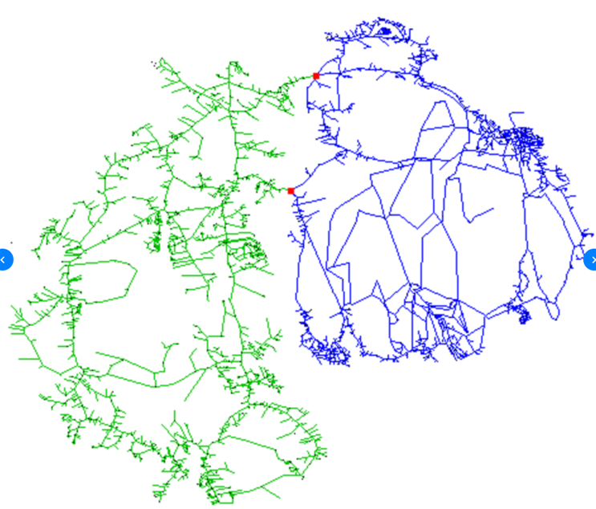
What’s the balanced-minimum cut

Slide 22

Max Flow Min Cut

Slide 23
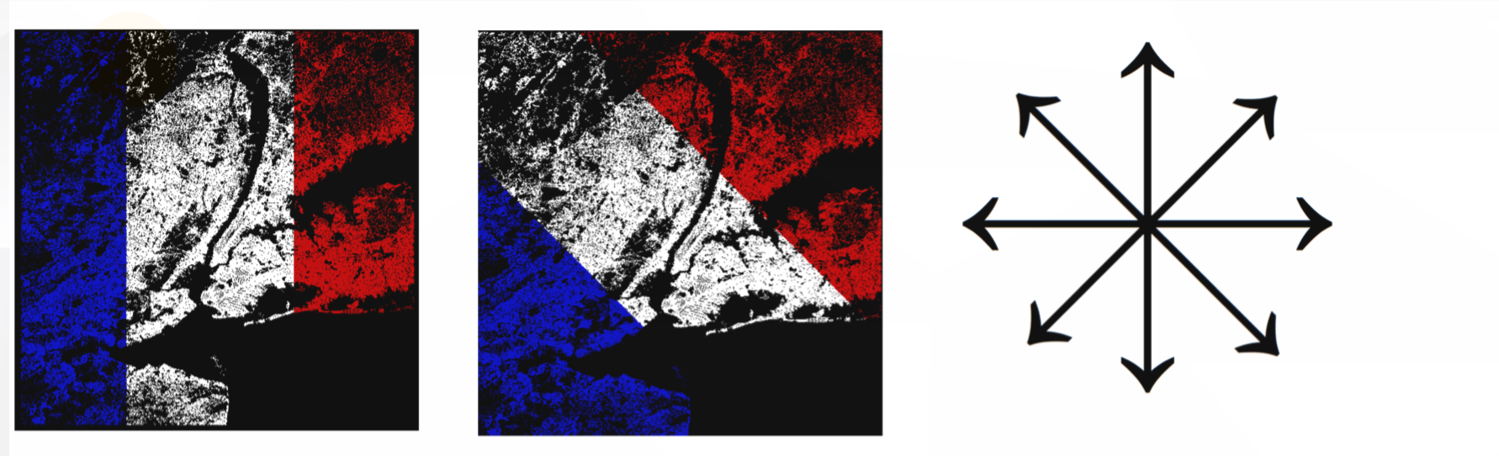
Try different cut to find minimum

Slide 24
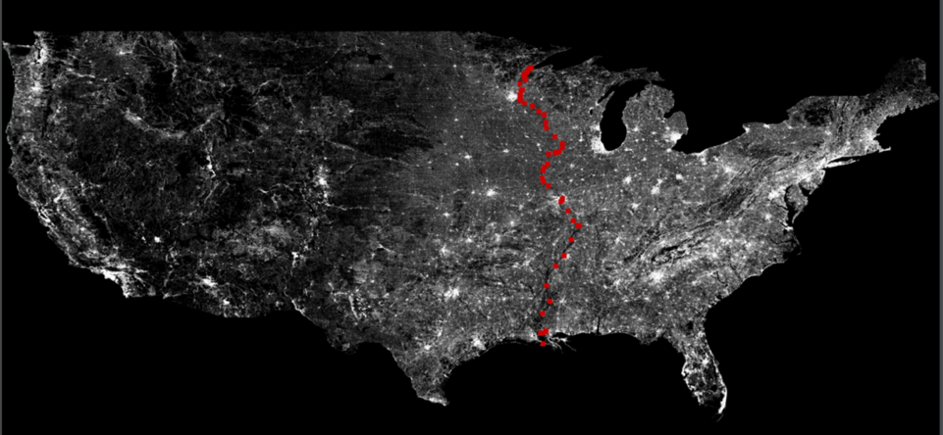
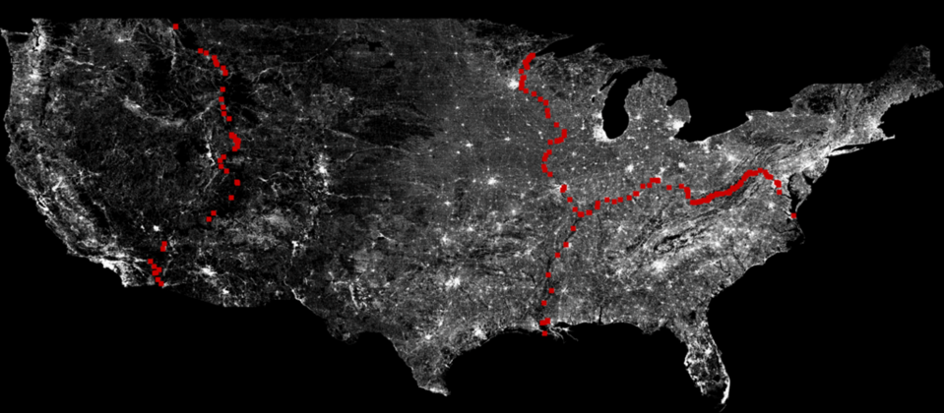
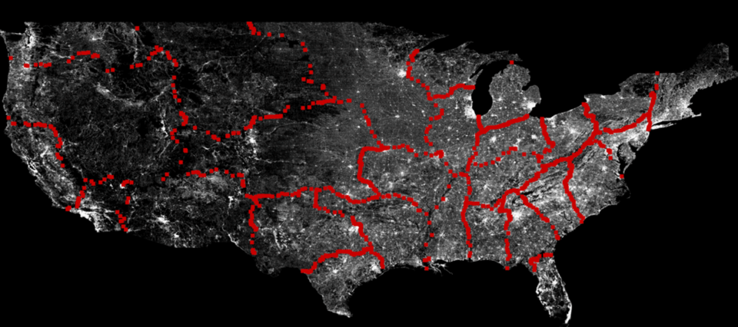
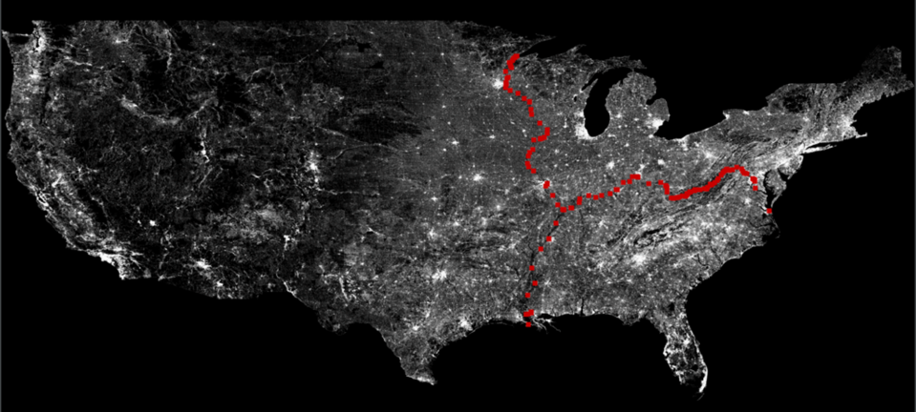
Partition graph of US

Slide 25
Offboard matching
Notes:
Picture layout

Slide 26
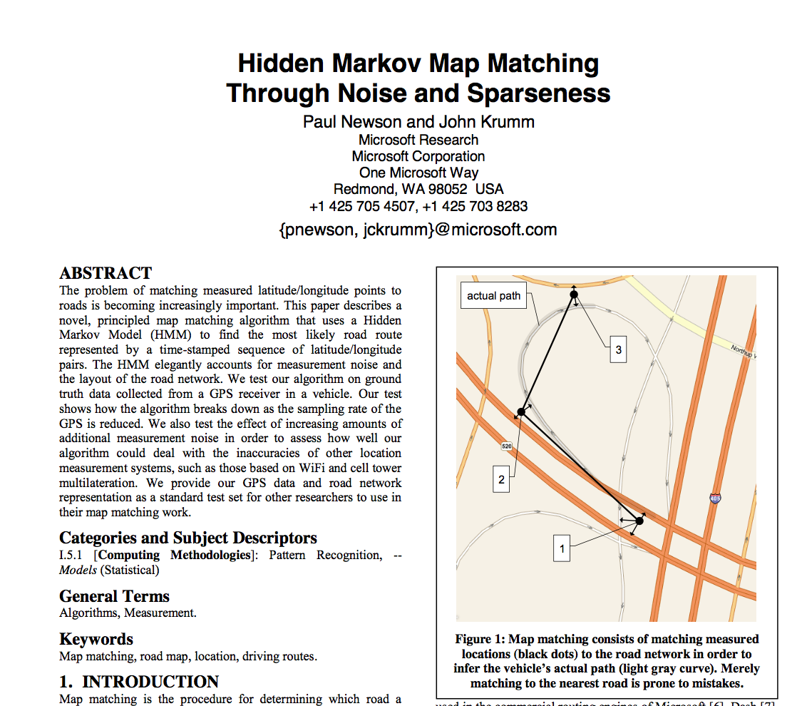
HMM Map Matching through noise and sparseness
Valhalla
OSRM
GraphHooper
Telenav
UBER
LYFT

Slide 27
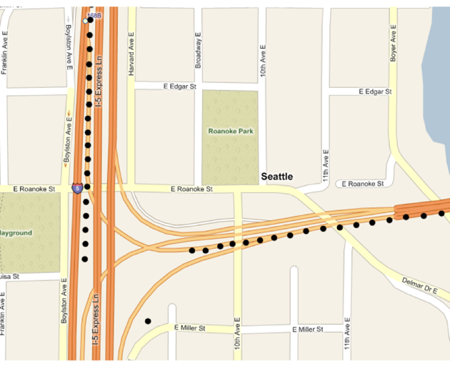
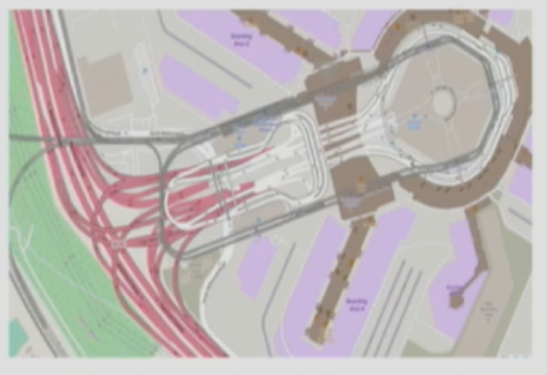
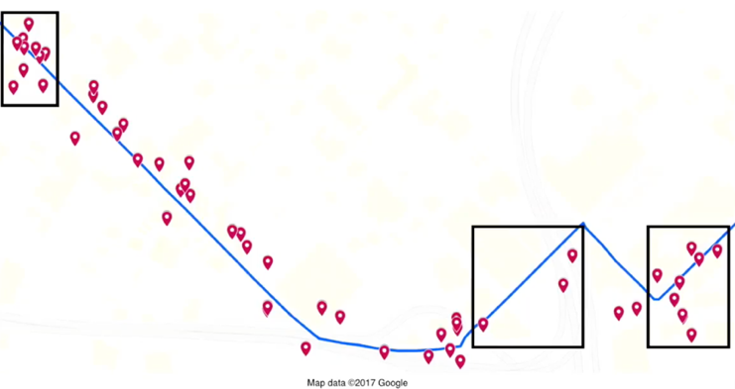
Offline Map Matching
Noise & Sparseness
Missing GPS
Wrong/Complex Map Data
Notes:
['tʌnl]

Slide 28
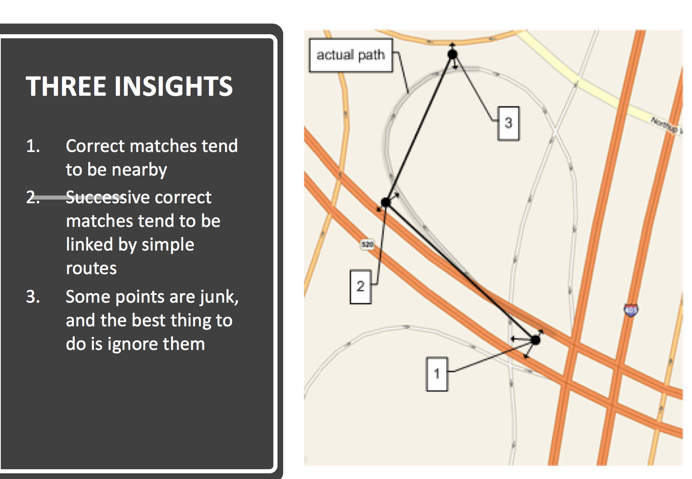

Slide 29
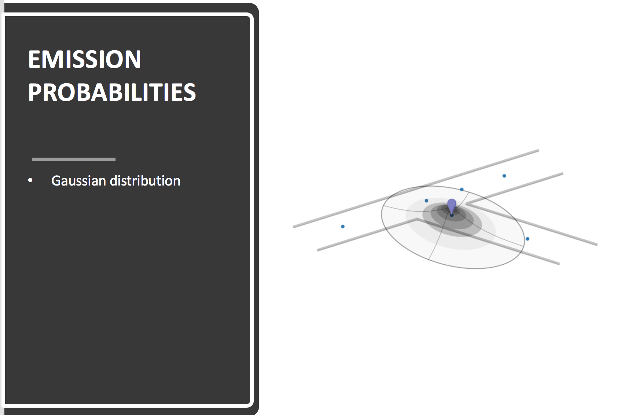

Slide 30
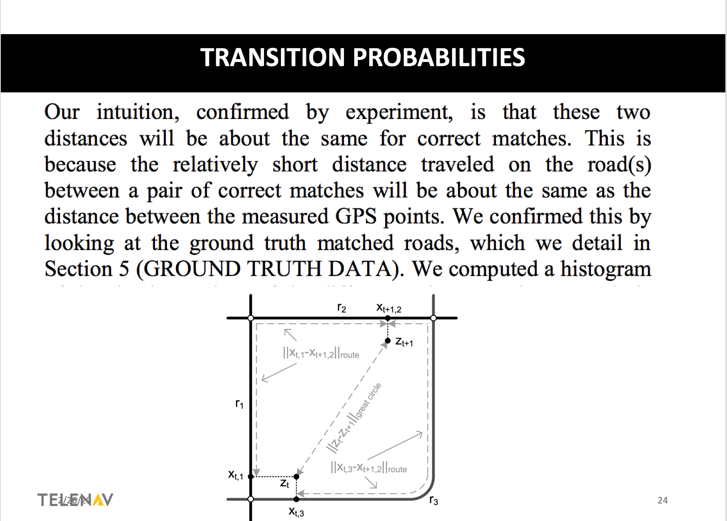

Slide 31
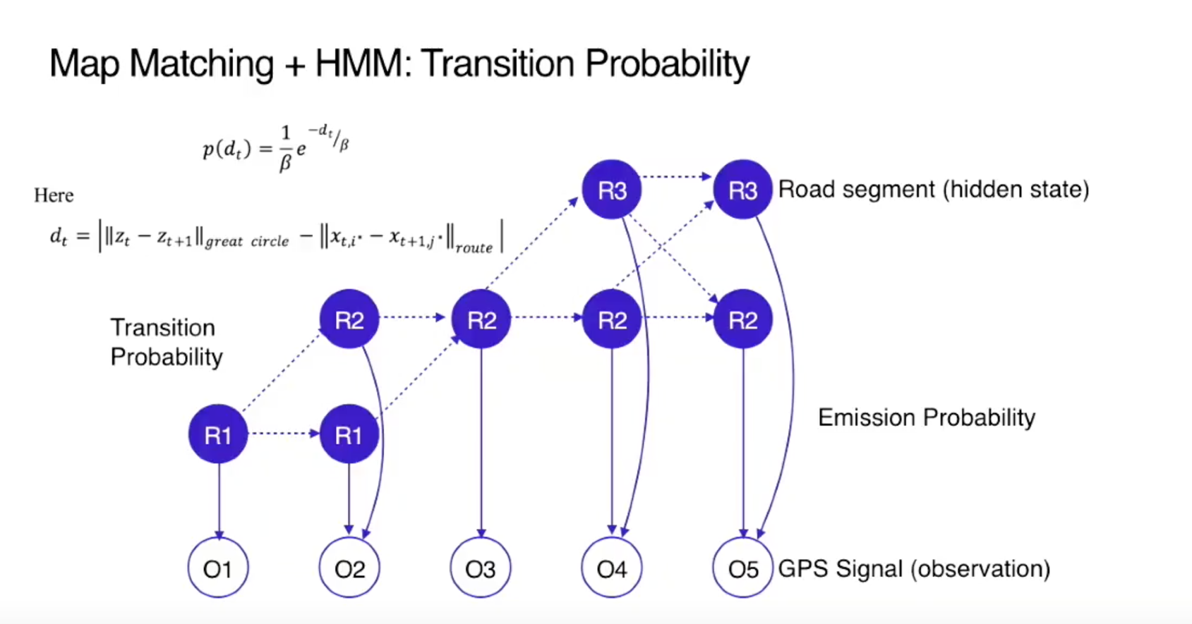

Slide 32

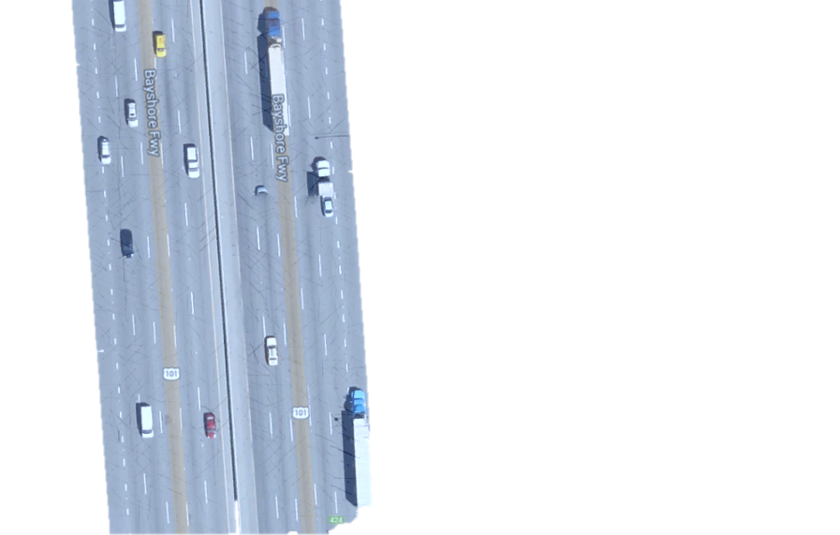
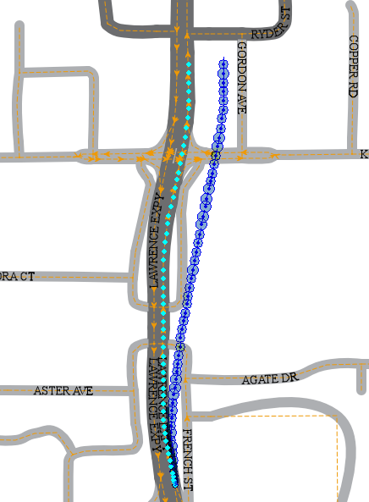
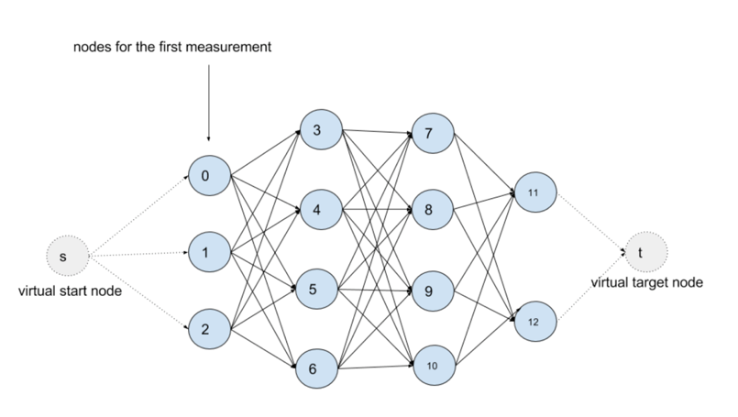
Offboard Map Matching logic
How
Filter noise points
Find Nearest edges as Candidate
Consider Connectivity
Optimal path
99% (2.05*errsize)
Kalman Filter
95% (1.65*errsize)
67% (1.00*errsize)
Emission Probability
MM Fix
DR Fix
Road Width
dmin
Transition Probability
Viterbi Algorithm
Hidden Markov Map Matching

Slide 33
What’s happening & next

Slide 34
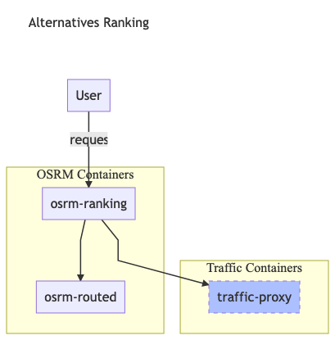
Alternatives Ranking Service
calculate N alternatives
calculate weight/duration for these N alternatives
rank by weight to get best one(or several)
Known Issue
N only allow max 3 for now

Slide 35
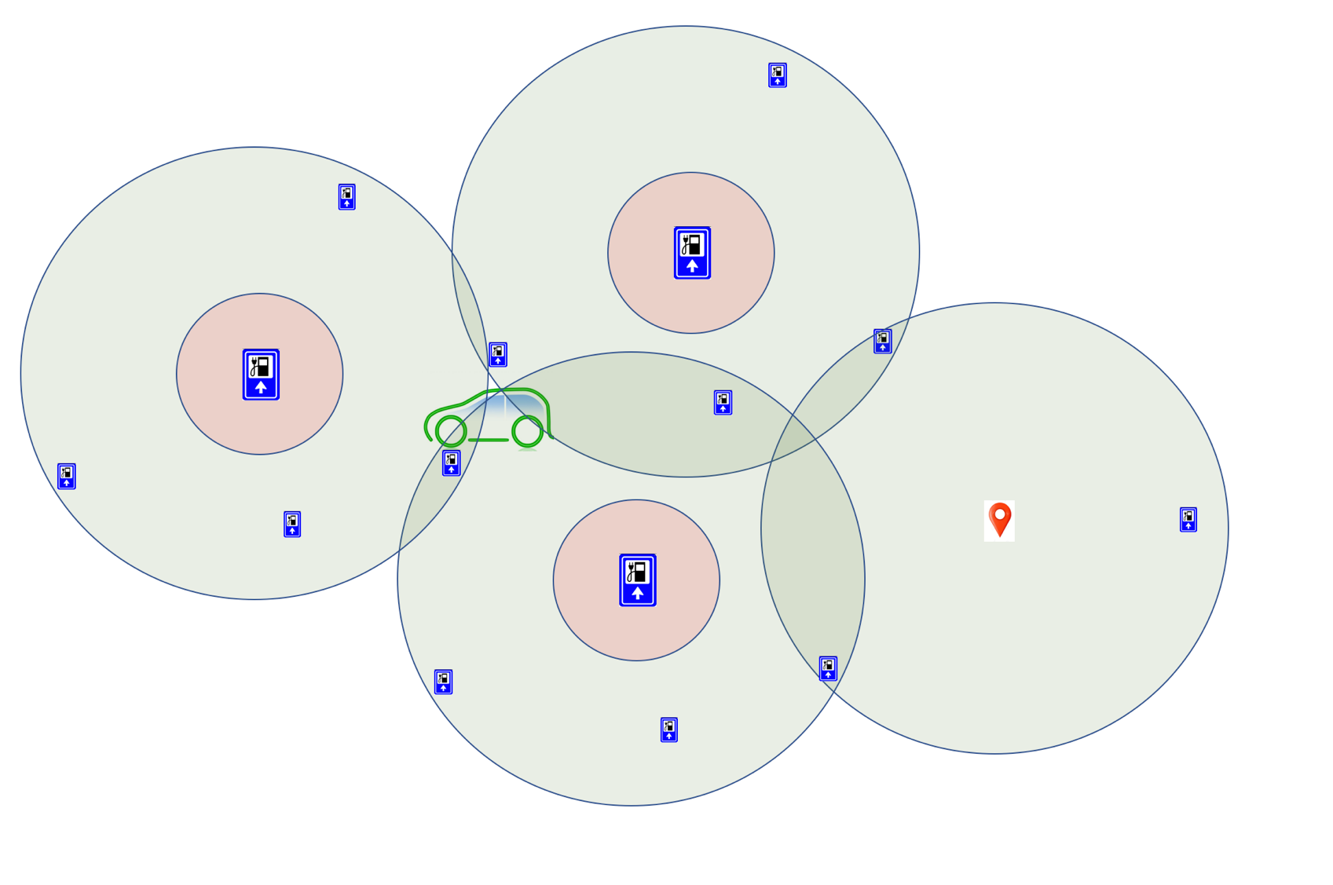
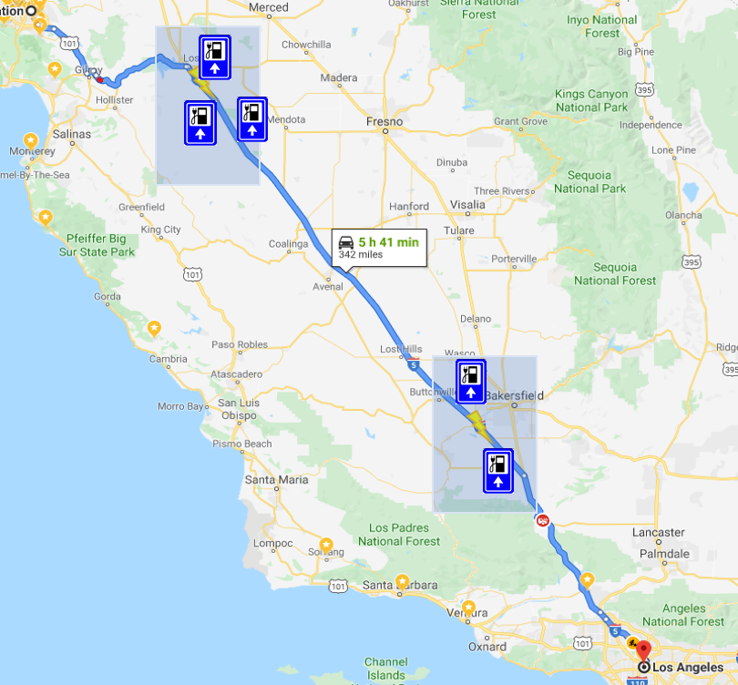
OASIS Service

Slide 36
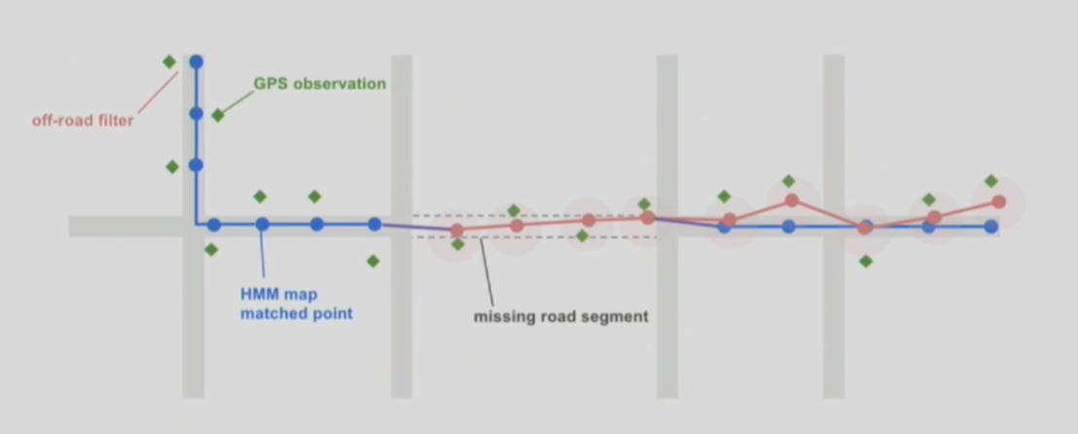

When map is wrong
High confidence
High confidence
Low confidence

Slide 37
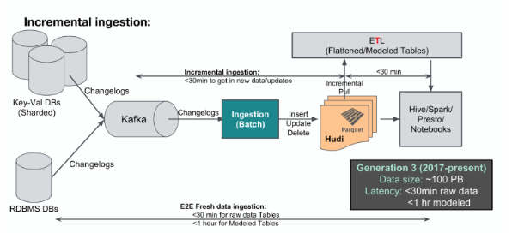
ETA enhancement
Low confidence

Slide 38

When map is wrong (LYFT’s way)

